Slide 1

Sports Analytics III
Produced by Dr. Mario
UNC STOR 538

Slide 2
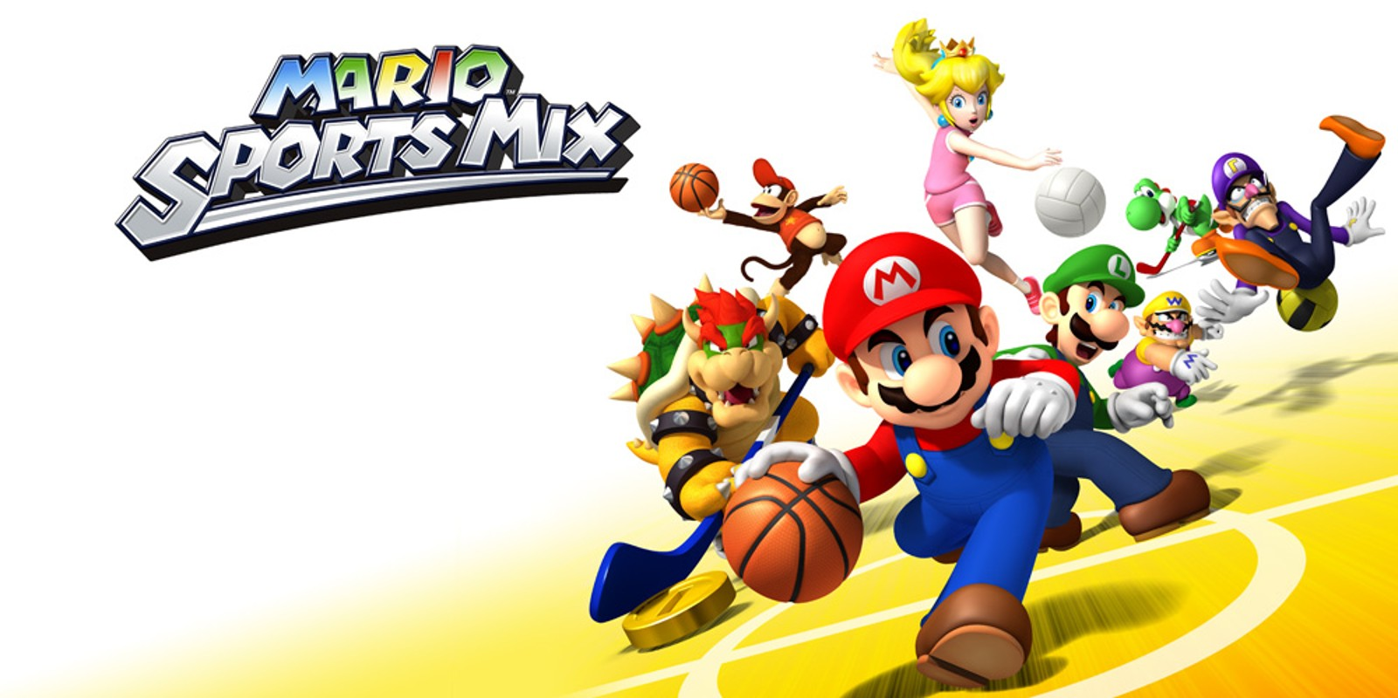
Industry Past
Sports Analytics Use Survey (2013)
Sample of 27 People (NFL, MLB, NBA, EPL)
How Many Different Sources?
1-2 (6.7%)
3-4 (33.3%)
5-6 (13.3%)
>6 (46.71%)

Slide 3
Industry Past
How Much Data is Centralized?
All (31.3%)
Most (37.4%)
Some (31.3%)
How Much Data is Dependent on One Person?
Some (50.0%)
Most (43.7%)
All Data Centralized (6.3%)

Slide 4
Industry Past
Is Data Checked for Errors?
Always (31.3%)
Usually (37.5%)
Sometimes (18.8%)
Occasionally (6.1%)
Rarely (6.3%)
How Many Database Programmers are Employed?
0 (37.5%)
1-2 (50.0%)
3-4 (0.0%)
>5 (12.5%)

Slide 5
Industry Past
How Many Statistical Analysts are Employed?
0 (20.0%)
1-2 (66.6%)
3-4 (0.0%)
>5 (13.3%)
Roadblock: Difficulty Identifying Strong Applicant
Difficulty in Both Hiring and Evaluating

Slide 6
Industry Past
Clear Process for Hiring/Evaluating Analysts
Strongly Agree (13.3%/14.3%)
Somewhat Agree (13.3%/14.3%)
Neutral (26.7%/28.6%)
Somewhat Disagree (13.4%/21.4%)
Strongly Disagree (33.3%/21.4%)
Analytic Resources in Line with Strategic Game Plan
Strongly Agree (26.7%)
Somewhat Agree (33.3%)
Neutral (33.3%)
Strongly Disagree (6.7%)

Slide 7
Industry Present
Value Placed on Sports Analytics
Global Sports Industry $600B-$700B (2018)
Include Business Dedicated to Sports $1.3T (2018)
Global Sports Analytics Market in 2021 = $1.79B
Expected CAGR between 2021 and 2028 is 28.1%
Projection in 2029
$Projection in 2021=1.79∗(1+CAGR)^$8 =12.66
$12.6B
$1.79B
2021
2029
Projections in 2029 According to MarketWatch.com

Slide 8
Industry Present
Three Reasons for Projected Growth Rate
Demand for Performance Tracking of Players
Demand for Solutions for Determining Player Value in Player Transfers
Demand in Analyzing Data from the Rise in Sports Technology Investments
Analysis from Emergen Research

Slide 9
Industry Present
Modern Applications of Sports Analytics
Helping the Team Win
Automated Video Analysis (Lincoln City, UK Football)
3D Depth Camera (NBA)
Wearable Technology (NBA, NHL)
Improving the Fan Experience
Analysis of Digital Engagement
Sentiment in Social Media
Analysis of Fan Behavior in Stadium (New England Patriots)
Wireless Internet and Phone Apps
Apps Supply Game Analytics, Parking Information, Promotions, and Traffic Information to the Fans (NFL)

Slide 10
Industry Present
Modern Applications of Sports Analytics
Benefiting Other Stakeholders
Tracking Fan Behavior Outside the Stadium
Telecommunication, Retailers, Payment Providers, Ticket Agencies, and Sponsorships
Adapt to Quick Changes in Consumer Behavior
Optimizing the Back-Office
HR Practices
Game Scheduling
Supply Chain Management and Logistics
Marketing and Promotions
Procurement of Goods and Services

Slide 11
Industry Present
Modern Applications of Sports Analytics
Advancing Sports Gambling
Supreme Court Ruling Previous Statute Violated 10th Amendment (Murphy v. National Collegiate Athletic Association)
States Free to Legislate Gambling
Improvement of Gambling Products
Data Aggregation and Visualization for Bettors
Develop Daily Fantasy Sports
Global Market worth $203B in 2020 (Statista.com)
US Revenue Forecasted to reach $2.5B in 2021 (Statista.com)

Slide 12
Your Industry Future
Prerequisites by Howard Hamilton
(Soccermetrics)
Technical Skills
Mathematics (Linear Algebra/Probability Essential)
Statistics (Frequentist and Bayesian Perspectives)
Machine Learning (Supervised and Unsupervised)
Programming (R/Python, Data Structures, OOP)
Databases
Visualization
Socials Skills, Ethics, and the Law
Knowledgeable About All Aspects of the Sport

Slide 13
Your Industry Future
Real Jobs (Indeed)
Manager, Fan Analytics for NHL
Data Visualization (Tableau)
Understand Sports Industry Standard Metrics
Python, R, SQL, or SPSS
Expert in Excel
Business Intelligence Analyst for YinzCam
Business Analytics in Sports
Databases, Machine Learning, Statistics, and Tableau
Masters Degree + Many Years of Experience

Slide 14
Your Industry Future
Real Jobs (Indeed)
Analyst, Sports & Entertainment for CLEAR
Business Analytics
Organize, Analyze, and Report on Data
Forecasting for Budgeting
Data Visualization (Tableeau)
Quantitative and Financial Modeling Skills
Analytics Manager for FanDuel
Degree in Quantitative Field (Math, Stats, Econ, etc.)
Proficiency in SQL and Excel
R, Python, Spark
Data Visualization in Tableau

Slide 15
Your Industry Future
Real Jobs (Indeed)
Director, Business Intelligence for Sporting KC
Contributor to Sports Marketing Department
Proficiency with Data Structures (SQL)
Proficiency with Data Visualization (Tableau)
Junior Analyst, Sports Analytics for FS&E
Global Sports Data, Technology and Analytics Consulting
Analyze and Interpret Complex Datasets
Python, R, SQL, VBA, SPSS

Slide 16
Your Industry Future
Real Jobs (Indeed)
Performance Data Analyst for Detroit Red Wings
Master’s Degree in Data Science
Collection and Interpretation of Performance Data
Basic Statistical Analysis Techniques
R or Python
Research Analyst for Bleacher Report
Mine, Analyze, and Deliver Data and Insights
Quantitative Research Experience
Experience with Statistical Analysis
R, SQL, SPSS, Tablewau

Slide 17
Your Industry Future
Conferences
Carnegie Mellon Sports Analytics Conference
Great Lakes Analytics Conference
MathSport International
MIT Sloan Sports Analytics Conference
New England Symposium on Statistics in Sports
Rochester Institute of Technology Sports Analytics Conference
Sports IDEAS Symposium
Uconn Sports Analytics Symposium
Compiled by Medium.com

Slide 18
Final Inspiration
Defense wins championships.
Offense wins contracts.
Be offensive.
- Mahatma Mario

